Slide 1
Cognitive Systems
Business Proposal
Team: F2M2, Group 12
Members: Lee Seng Tea, Ng Siew Pheng, Yang Xiaoyan, Tarun Rajkumar

Slide 2
SG Events Finder Chatbot
For someone new to singapore.

Slide 3
Whats happening SG ?
Events-Categories-Artists-Locations

Slide 4
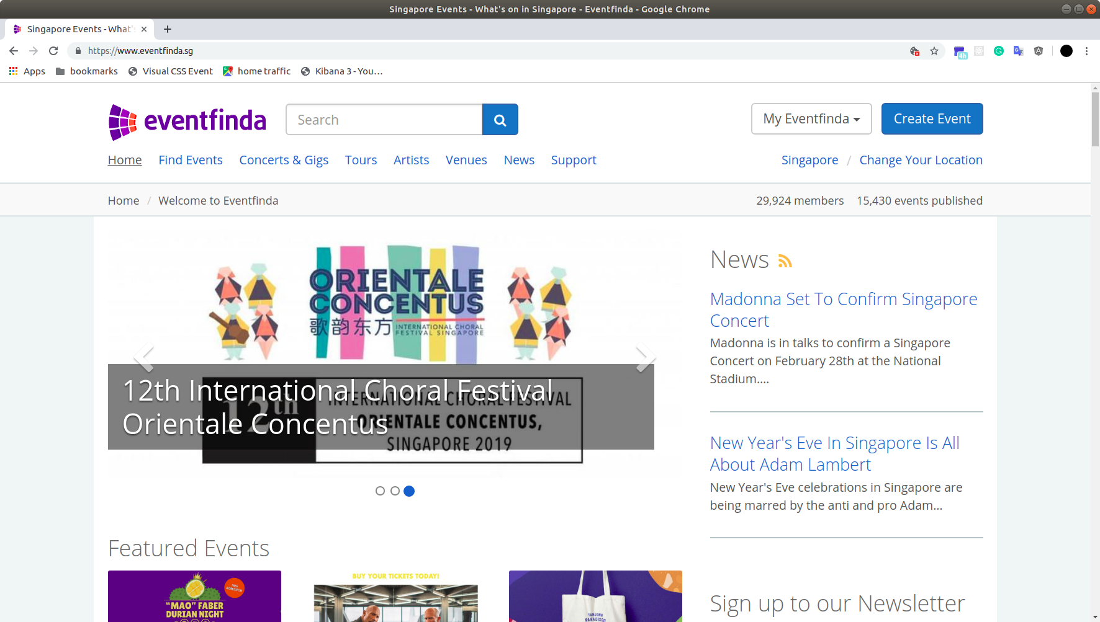
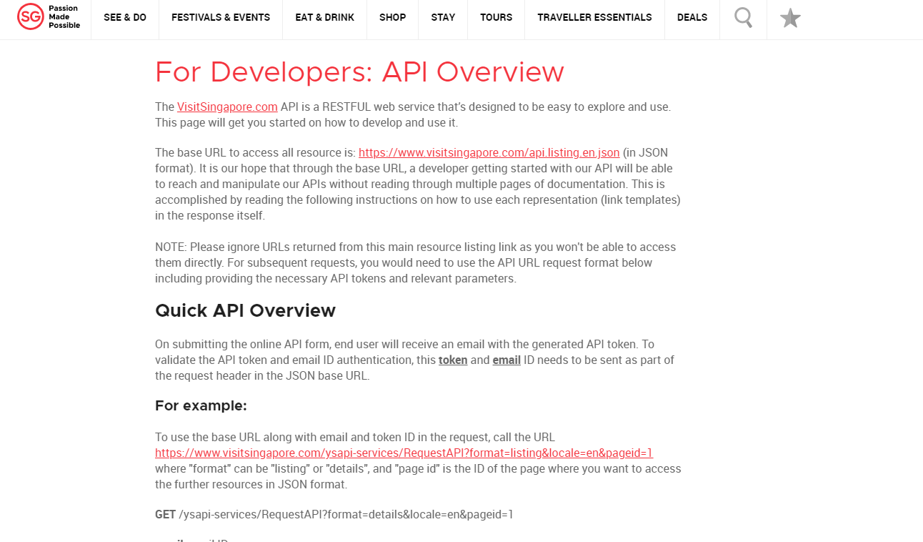
Knowledge Base: eventfinda.sg visitsingapore.com

Slide 5
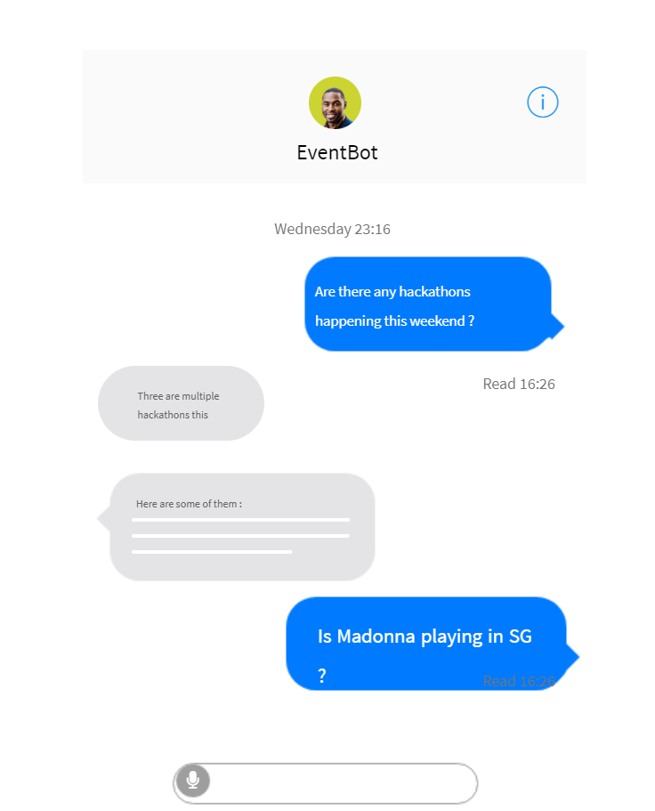
Mock Design & Sample Questions
Is there a music festival in Singapore?
When is Spectra scheduled for ?
What are the events at Sentosa ?
Charity events near me ?
MMA events scheduled next week?

Slide 6
Possible Extensions
Might do: Maps integration: GMaps What’s the typical traffic status? Social Integration : Invite friends Email my friends about that event? What’s the weather during the/this event? OpenWeather perhaps ? Could do: User Personalisation: Where to go today? Recommendation based on past events or even past searches. Far fetched: Chatbots Collaboration: EventBooking chatbot, FoodFinder chatbot et cetra… UnHappy with your job ? - Talk to Career Coach
P/S: Extensions will be based on availability of APIs that we can find.
Notes:
APIs:
events
https://www.eventfinda.sg/api/v2/events
https://www.visitsingapore.com/contact-us/api-request-form/api-overview-document/
Typical traffic:
https://data.gov.sg/dataset/carpark-availability
https://data.gov.sg/dataset/carpark-rates
https://data.gov.sg/dataset/road-traffic-conditions
weather/pollutions:
https://data.gov.sg/dataset/weather-forecast
https://data.gov.sg/dataset/psi

